Slide 1

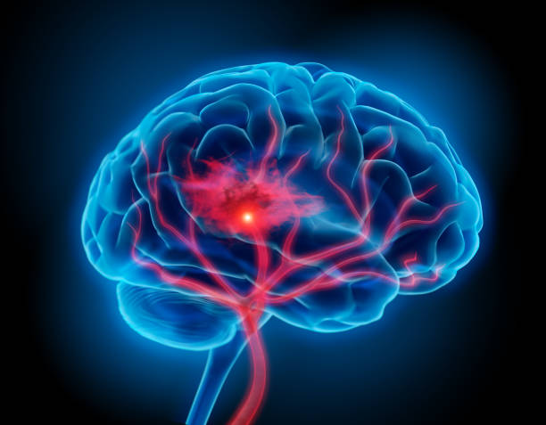
STRoke disease prediction
Student name : Manisha Basera
University roll no. : 2018468

Slide 2
content
1. Overview of Project
2.Libraries
3. K-Nearest Neighbours
4. Conclusion

Slide 3
Introduction
Stroke is the second leading cause of death worldwide and one of the most lifethreatening diseases for persons above 65 years. It injures the brain like “heart attack” which injures the heart. Once a stroke disease occurs, it is not only cost huge medical care and permanent disability but can eventually lead to death. Every 4 minutes someone dies of stroke, but up to 80% of stroke can be prevented if we can identify or predict the occurrence of stroke in its early stage. Stroke is a blood clot or bleed in the brain which can make permanent damage that has an effect on mobility, cognition, sight or communication. Stroke is considered as medical urgent situation and can cause long-term neurological damage, complications and often death

Slide 4
Problem statement
Stroke is the second leading cause of death worldwide and remains an important health burden both for the individuals and for the national healthcare systems. Potentially modifiable risk factors for stroke include hypertension, cardiac disease, diabetes, and dysregulation of glucose metabolism, atrial fibrillation, and lifestyle factors.
Therefore, the goal of our project is to apply principles of machine learning over large existing data sets to effectively predict the stroke based on potentially modifiable risk factors. Then it intended to develop the application to provide a personalized warning based on each user’s level of stroke risk and a lifestyle correction message about the stroke risk factors.

Slide 5
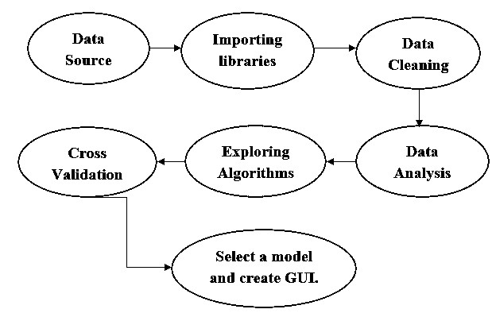

Slide 6
libraries
NumPy
Python library which deals with arrays, basically used for scientific computations. Used for performing linear algebra, matrix multiplication, Fourier transform.
Pandas
Used analyze data. Works on various file formats such as SQL, JSON, Microsoft Excel. Data manipulation operations such as merging, selecting, reshaping and data cleaning in general.

Slide 7
Matplotlib Pyplot
Has collection of functions that makes matplotlib works like MATLAB. Basically, used for data visualization, also includes functions such as creating a figure, plotting area etc.
Seaborn
It is a data visualization based on matplotlib. It provides high-level interface for drawing informative and attractive graphs.
Tkinter
It is a simple and easy to use in-built python model used for designing user interface. Here this module is used to create 1920x1080 window with the necessary widgets for taking inputs.

Slide 8
K-Nearest Neighbours
K-Nearest Neighbours is one of the most basic yet essential classification algorithms in Machine Learning. It belongs to the supervised learning domain and finds intense application in pattern recognition, data mining and intrusion detection. It is widely disposable in real-life scenarios since it is non-parametric, meaning, it does not make any underlying assumptions about the distribution of data (as opposed to other algorithms such as GMM, which assume a Gaussian distribution of the given data). We are given some prior data (also called training data), which classifies coordinates into groups identified by an attribute.

Slide 9
Conclusion
The completion of the project went quite well, I learned many new things while I was building it, and I get up to know various platforms which help us to learn all this stuff. I was able to learn the practical use of various algorithm. The practice helped me to learn the debugging of code and many more things.
Overall working on this project was great fun as I came up with a great piece of knowledge and understanding of the topic.

Slide 10

Thank You

